Slide 1



Scalable Analytics Final Project Team IX
Yelp Datasets Analysis
Abhijeet Kothari Asheesh Kumar Namit Srivastava Harshit Bhargava

Slide 2
Project Summary
Objective: Yelp is an app/website which publish crowd-sourced reviews as well as online reservation service. The objective of this project was to study the available datasets and come up with interesting insights. In this project we also used Google Cloud Platform for data processing and cluster computing
Approach: a) Sliced and analyzed the data on local machine
b) Created a framework to be replicated on the server
c) Tested pyspark (.py) codes on local machine before running on the cluster
d) Cleaned the data with invalid values

Slide 3
Data Description
User is a person who has registered on yelp who is writing reviews about different business after vising them or a person who is using yelp reviews to choose business.
Review is usually short text consisting of few lines with about hundred words.
This dataset is a subset of Yelp's businesses, reviews, and user data.
Questions:
Reviews: What are some top words associated with high and
low ratings?
Businesses and their locations: What type of business categories are rated higher than others?
Review Table
review_id | VARCHAR
Business_id | TEXT
User_id | TEXT
review | text
Review_stars | float
Review_date | date
State | TEXT
Business Table
business_id | VARCHAR
Categories | TEXT
City | TEXT
name | VARCHAR
Review_count | INT
B_stars | Real
State | TEXT
Is_open | INT
Users Table
User_id | VARCHAR
Review_count | INT
Yelping_since | DATE
Average_stars | Float
N:1
1:N

Slide 4
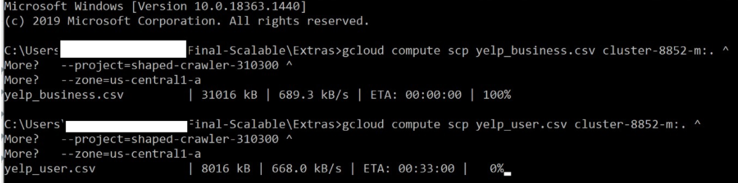
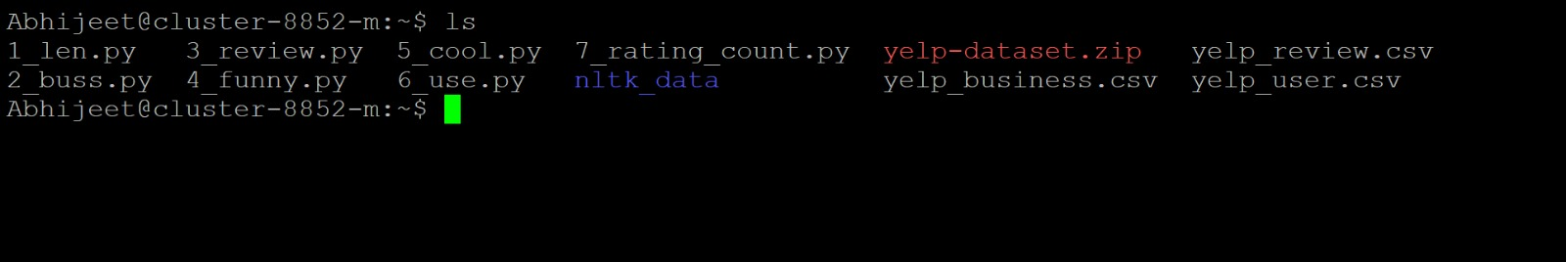
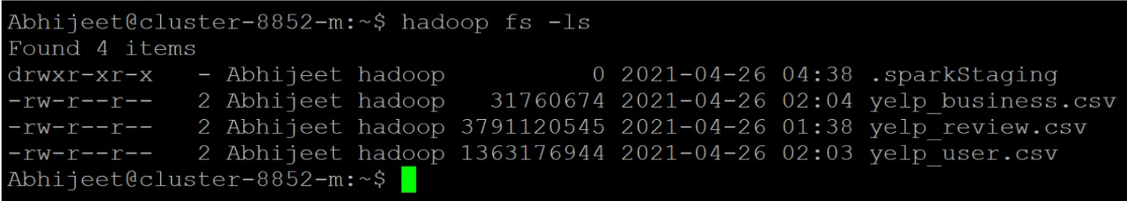
Google Cloud Usage
Uploading Data Files on Google Cloud
Python Script files on cluster
Datafiles deployed on Hadoop File System

Slide 5
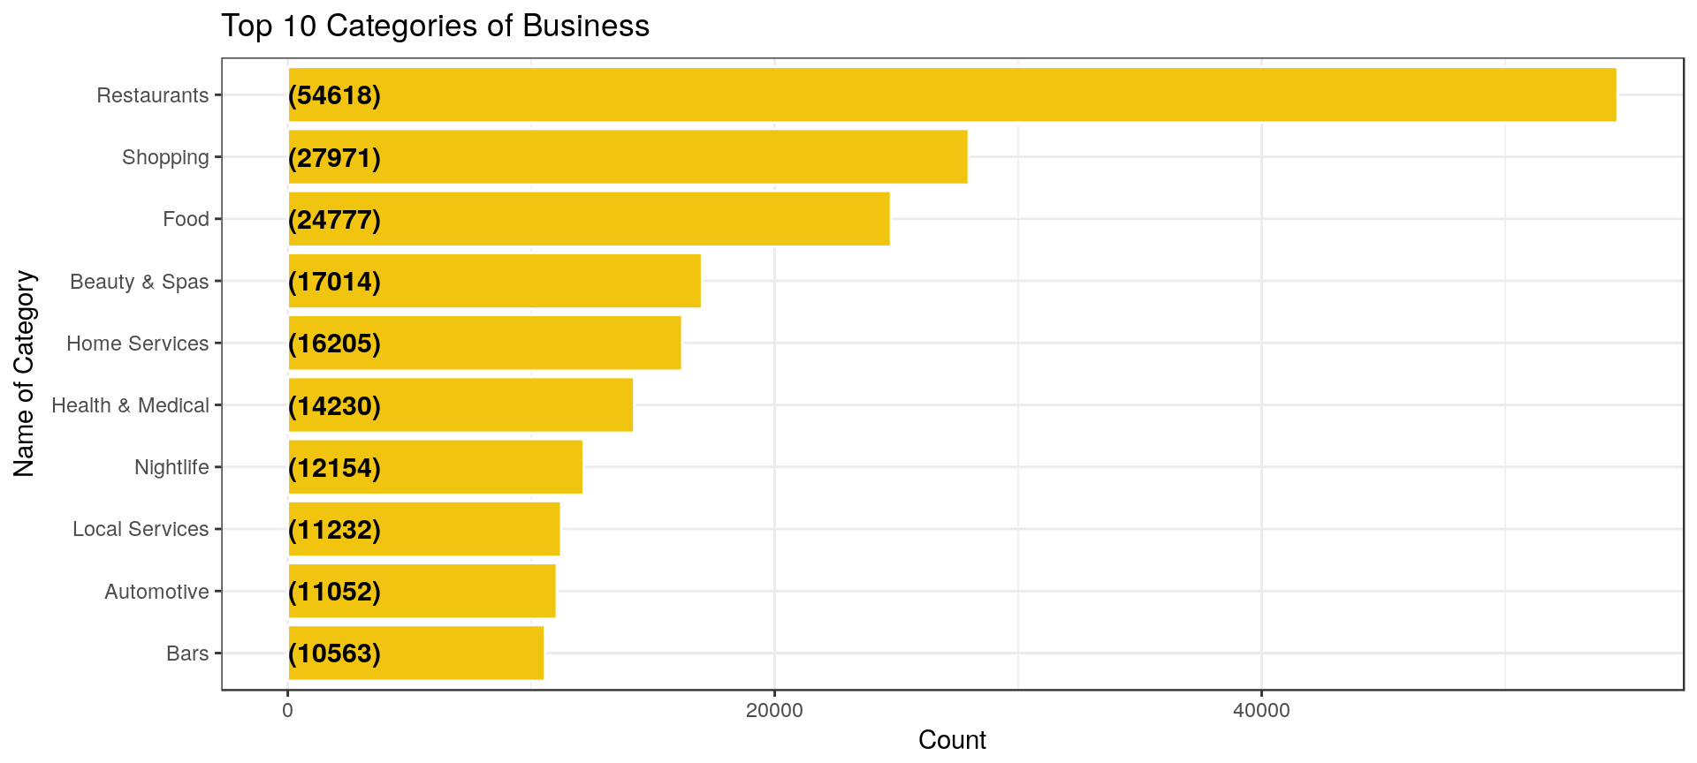
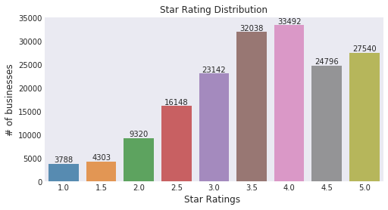
Preprocessing Steps

Slide 6
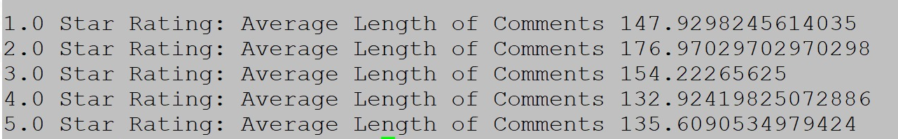
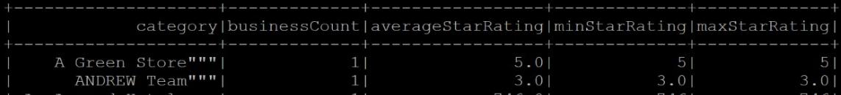
Key Takeaways
Insight 1 : Average Length of Comments of different Ratings
Insight 2 : Average / Minimum and Maximum Star Ratings

Slide 7
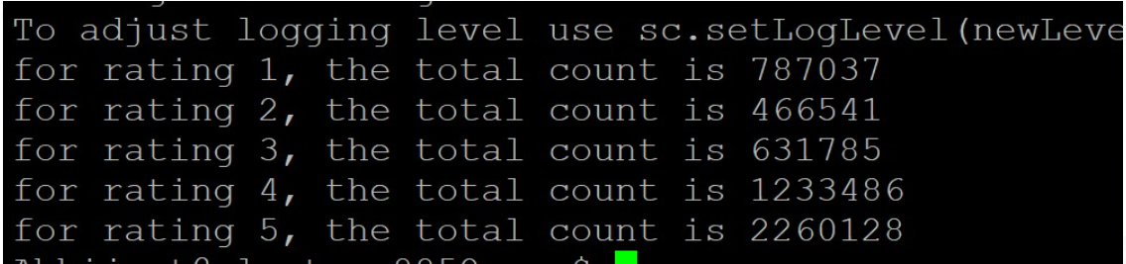
Key Takeaways
Insight 3 : Total Count of reviews for each Rating

Slide 8
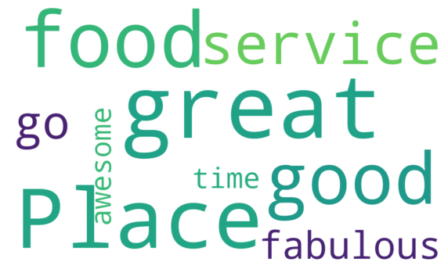
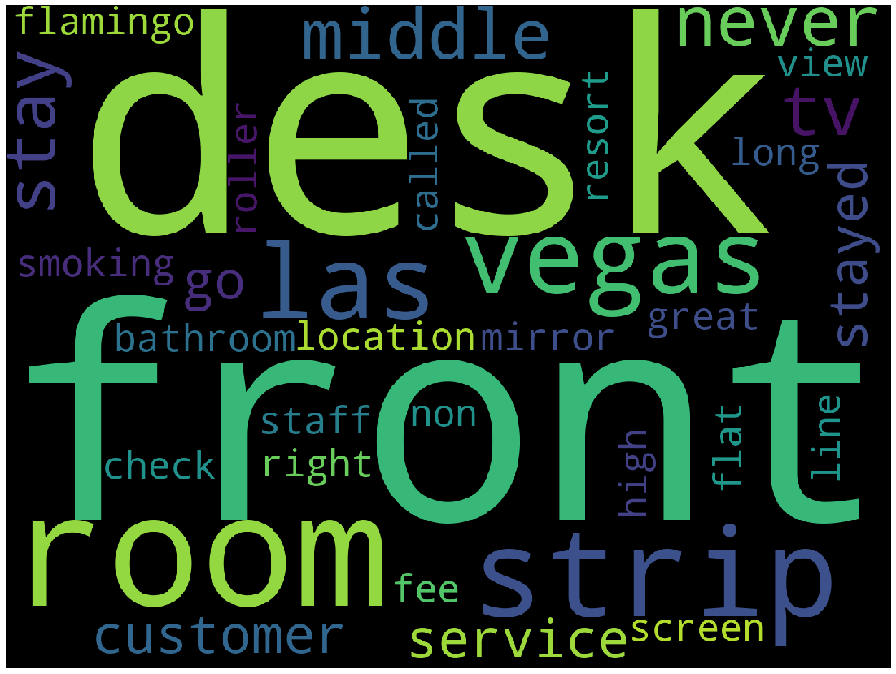
Key Takeaways
Insight : Segregation of Review comments on different search criteria's
Unique Cool words Most Frequent words in Negative reviews

Slide 9


